Slide 1
Financial Management Information System (FMIS)
User Training Session

Slide 2
Agenda
Training Overview
Data Availability
System Access and Log-in
Most Frequently Used Queries
Sorting and Filtering
Saving and Printing
2

Slide 3
The purpose of today’s training is to provide a thorough understanding of FMIS, the data it contains, and the reports which it generates
At the completion of today’s training, you should understand the Learning Objectives and be able to perform the Key Take-Aways:
Data Availability
Accessing FMIS
Queries
Printing and Saving
Understand the VAT data collection process and update frequencies
Understand the data and the VAT data collection process and update frequencies
Access FMIS and distinguish between the different log-in screens
Access FMIS and distinguish between the different log-in screens
Compare and contrast the various queries available for data gathering and ways to manipulate query data
Navigate through network drives in order to save and print reports generated in FMIS
Learning Objectives
Understand the VAT data collection process and update frequencies
How VAT data is collected and when refreshed data will be available
How VAT data is formatted in FMIS
How to successfully log-in to FMIS
Trouble-shooting tips for accessing the application
Differences between Query Grids and Non-Query Grids
When and how to use Wild Cards and operators
How and when to use the most frequently-utilized queries in FMIS
How to save query results to their local hard drive or to the network for retrieval and use later
How to successfully print query results to mapped printers
How to resolve common printing and saving issues
Key Take-Aways
3
Notes:
3
- Today’s presentation/training will follow the storyline outlined here – you will be able to tell where we are in the training by the highlighted chevrons in the upper right corner

Slide 4
FMIS provides users with a consolidated view of Pegasys, NEAR and CCR data
FMIS was originally created to make National Electronic and Accounting Reporting Application (NEAR) data accessible via a modern query tool
In 2002, FMIS underwent a significant modernization to incorporate data from Pegasys
FMIS employs robust database level scripting to reformat and store financial data in an easy to understand format for consumers of financial information
FMIS is used by personnel in Regional Finance Centers, business line financial operations personnel, Central Office finance users, and the Office of Financial Management Systems
Inputs and Outputs of FMIS Data
4
Notes:
4

Slide 5
Data available in FMIS is largely driven by Valid Accounting Transactions (VATs) from Pegasys
VATs are detailed Pegasys journal entries
VATs are extracted from Pegasys each day from the accounting journal, transaction journal, general ledger journal and fixed assets journal
Category Lists are pre-filtered by major Standard General Ledger (SGL) functional category and code
Category | Code
Assets | 14XX, 15XX, 16XX, 17XX, 18XX, 19XX
Income | 5XXX and 71XX, excluding 5610
Expense | 6XXX, 72XX
Obligations | 4801, 4802, 4899, 4901, 4902, 4881, 4882, 4981, 4982
Delivered Orders | 4901, 4902
Prior-year Recoveries | 4871, 4872, 4971, 4972
Deferred Income | 2320.01, 2310.04, 2310.01
Unfilled Customer Orders | 4221, 4222
Other data available in FMIS include:
Pegasys Open Items – Daily cycle updated open obligations balances
Pegasys Trial Balances – Detailed trial balance from General Ledger (GL) summary tables
NEAR/Pegasys Crosswalks - NEAR general ledgers and corresponding SGLs
NEAR Edit Process Query - Rejected NEAR transactions and reason
5
Notes:
5

Slide 6
The Pegasys and other data housed in FMIS is not in “real time” – it is updated overnight on a daily basis
VAT data is pulled from Pegasys and up-loaded to FMIS each day, Monday-Saturday mornings, with a daily cutoff time of 05:00 GMT (weekends are merged into Sunday’s VAT and loaded Monday morning)
New journal items and updated accounting-related fields trigger an update in FMIS’ sweep of General Ledger updates
Open Items and Trial Balance data from Pegasys are also available through FMIS; they are also refreshed each day, Monday-Saturday, at midnight EST
Representation of FMIS Data Update Schedule
1
Pegasys Open Items
2
Pegasys Trial Balances
Pegasys Transactions
4
FMIS Database Updated
3
Other Data Updates: NEAR/Pegasys Crosswalks, NEAR Edit Process Query, CCR
6
Notes:
6
- Note to users that FMIS is not updated in real time, but once a day each morning with the previous day’s activity
- Explain that not all updates constitute an accounting-related update (e.g. an updated amount or code for a transaction would be caught by FMIS’ update process; an updated note, however, would not)

Slide 7
Exercise: You know an order was processed in Pegasys this morning and cleared, but you cannot find it in FMIS – why not?
Pegasys data is updated in FMIS once per day, so the order will not be available until tomorrow
There is an error and the FMIS data is likely compromised
The Pegasys data hasn’t replicated to Pegasys yet and should be available in an hour
Your Pegasys document number is incorrect
The Pegasys data cut-off is at 05:00 GMT (approx midnight) each morning to be updated in FMIS by approximately 6:00 EST – data is not updated in real time
7
Notes:
7

Slide 8
Exercise: The description field of a document was updated in Pegasys yesterday but that update is not represented in FMIS today – why not?
There has been an update error and FMIS’ data is likely compromised
The cut-off amount for data updated in FMIS is any transaction above $100, so if the amount is below that, it won’t be updated
Your search probably contains inaccurate document numbers
Not all updates trigger a new journal creation, so some data updated in Pegasys will not be caught by the FMIS update process
Non-accounting related fields don’t trigger a journal entry, which are required to be ‘caught’ by FMIS’ update process
8
Notes:
8
- Non-accounting related fields don’t trigger a journal entry
- Some General Ledger transactions won’t have a debit or credit amount, which is valid

Slide 9
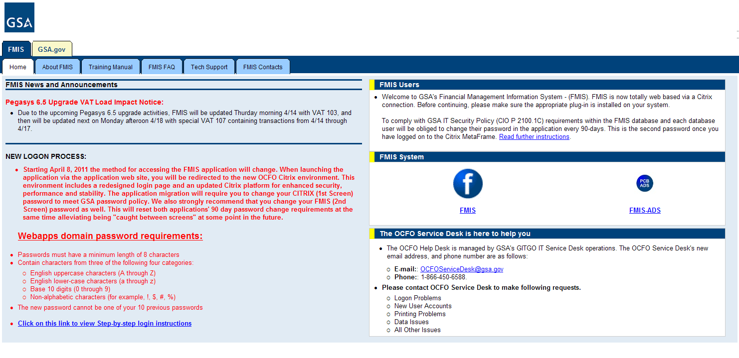
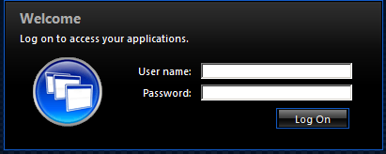
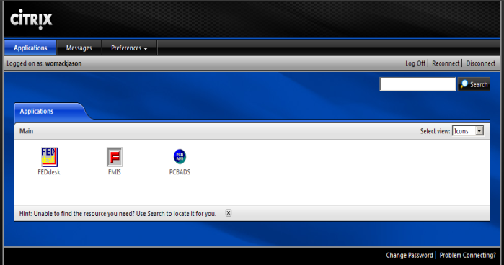
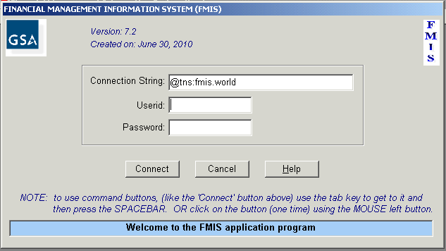
Accessing and logging-in to FMIS is a quick, four-step process that you can complete inside or outside of the GSA network
1
Navigate to the FMIS website and click ‘FMIS:’
Users on the GSA network: http://cfo.fmis.gsa.gov
GSA external clients outside of GSA’s network: https://xpwi.gsa.gov
1
The Citrix client web interface will launch. Log-in with your FMIS ID and your password – you will be prompted to change your password after logging in for the first time
At the Citrix Application Menu, click the FMIS logo
You will be prompted to log-in a second time, this time to access FMIS. Use your log-in credentials provided by the OCFO IT team
2
2
3
3
4
Important Note: Teleworkers should FIRST establish a connection through the VPN before completing step 1
4
9
Notes:
9
- Users should bookmark this URL.
- It is recommended that you also select ‘Never ask me again’ – once you do this, the File Security Screen will not appear in future FMIS sessions.
- We recommend that you do NOT login through the Enterprise Citrix client, then log-in to the FMIS Citrix Client – users will not be able to save or print their queries if they do this.

Slide 10

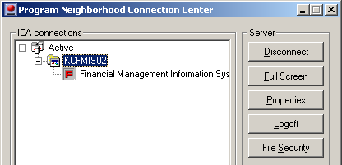
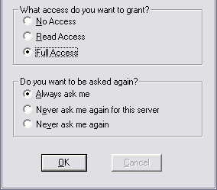
If you have logged-in to FMIS and do not have full access rights, you are able to grant full access rights from within the application
Full Access rights are required to make use of all of FMIS’ functionality, including the ability to print and save your queries
To login with full access after logging in…
Double-click the Citrix Program Neighborhood Connection Status icon in your system tray icon
Click the FMIS connection
Click the ‘File Security’ button
The Client File Security window will then appear – select ‘Full Access’
Click ‘OK’
1
1
2
3
4
2
3
5
4
5
10
Notes:
10
- Recommend that you select ‘Never ask me again’ in the Citrix File Security window

Slide 11
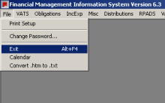
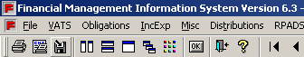
Logging-out of FMIS improperly and expired log-ins can create system access issues for users
To properly log-out of FMIS:
Click ‘File’ in the main menu bar and then select ‘Exit’
You can also click the blue door icon in the toolbar of a query report
1
1
2
2
Important Note: If you do not properly log-out of FMIS, you may be blocked from accessing it again for over an hour
11
Notes:
11
- Be sure to log-out properly to ensure access the next time you need to use FMIS
- If you have trouble logging-in, contact the OCFO Service Desk; but you may have to wait 1 hour to log-in after closing the application without properly logging-out of FMIS

Slide 12
To help alleviate log-in issues, a best practice is to update your Citrix and FMIS passwords at the same time – before the 90-day mandatory password change occurs
FMIS users are required to change their passwords every 90 days
The Citrix client will prompt users to update their password starting at 14 days before the 90-day date is approaching
After you update your Citrix password, you should then change your password in FMIS under the ‘File’ menu
To change your FMIS password, click ‘File’ → ‘Change Password’; and proceed with the prompted steps
Password guidance:
Passwords must be at least 8 characters in length and include at least one letter, number and a special character
Passwords are case sensitive, usernames are not
Acceptable special characters are:` ~ ! @ # $ % ^ & * ( ) _ + - = { } | [ ] \ : " ; ' < > ? , . /
Important Note: FMIS will not allow you to change your password after the 90-day mark has passed, so you must be diligent about updating it prior
12
Notes:
12

Slide 13
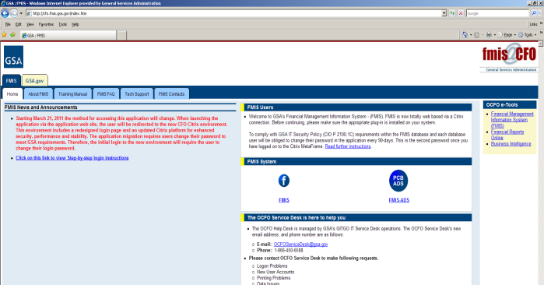
Exercise: How do you log-in to FMIS?
Click the Citrix icon in System Tray → Log-in to the Citrix Client → Log-in to FMIS
Navigate to the FMIS website and click ‘Enter FMIS’ → Log-in to the Citrix client → Log-in to FMIS
Log-in to the OCFO homepage → Click ‘Citrix Connections’ → Log-in to Citrix → Open the Citrix Connection Center window → Log-in to FMIS
Navigate to the FMIS website and click ‘FMIS’ → Log-in to the Citrix client → Click the FMIS icon → Log-in to FMIS
13
Notes:
13

Slide 14
Exercise: You logged in to FMIS, but without Full Access – how can you change your settings to Full Access?
Log-out of FMIS → Log-in to FMIS → Be sure to select ‘Full Access’
You must log-out of FMIS and wait one hour
Click the Citrix icon in your System Tray → Click the FMIS connection → Click File Security → Select ‘Full Access’ in the window that appears and click ‘OK’
Contact the OCFO Service Desk
14
Notes:
14

Slide 15
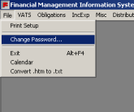
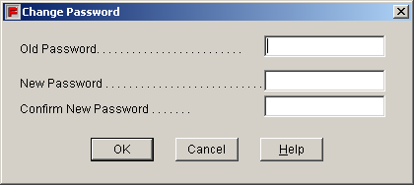
Exercise: After changing your Citrix password, you successfully log-in to FMIS – what should your next step be?
Clap your hands and proceed with your reporting needs
Contact the OCFO Service Desk to tell them that you have updated your password and request a new FMIS password
Nothing, the updated Citrix password will automatically replicate to the FMIS security database and be your new log-in password for both screens
In the ‘File’ menu of FMIS, select ‘Change Password’ to update your FMIS log-in password
15
Notes:
15

Slide 16
There are the two types of queries available in FMIS, Query Grids and Non-Query Grids, both of which make use of Wild Cards when executing a query
Query Grids
Non-Query Grids
Resemble spreadsheets (rows and columns of data in cells), in which searches can be performed for any value of any data element
Query Grids are flexible and allow users to add their own search criteria and logical operators
Useful when you want to search with multiple criteria
Prompt the user to input selection criteria, and return data in various report formats
Non-Query Grids are similar to a canned report with pre-defined search criteria to choose from
Useful when you know the specific Pegasys data value
16
Notes:
16

Slide 17
Logical operators and Wild Cards give users significant flexibility when using a Query Grid
Operators will query data based on their meeting the operator’s requirements or not, providing FMIS users with a great deal of flexibility to create unique queries
For example, users can search for Object Classes 12, 14, and 52 by searching for IN (’12’, ’14’, ‘52’) in the Object Class accounting dimension
When performing queries in FMIS, users can leverage two types of ‘Wild Cards’ – operators which will return data that matches certain patterns or contain certain characters:
% (percent sign): Any number of characters of any value will be returned
_ (underscore): One character, of any value will be returned
For example, users can search for transactions with Pegsys Document Numbers that begin with 3KFY11 by searching for LIKE 3KFY11% in the appropriate accounting dimension
FMIS-Supported Operators
LIKE | NOT LIKE
Less Than (use <) | Greater Than (use >)
AND | OR
IN
17
Notes:
- Point out that when performing a query using a Wild Card, the LIKE operator is always required

Slide 18
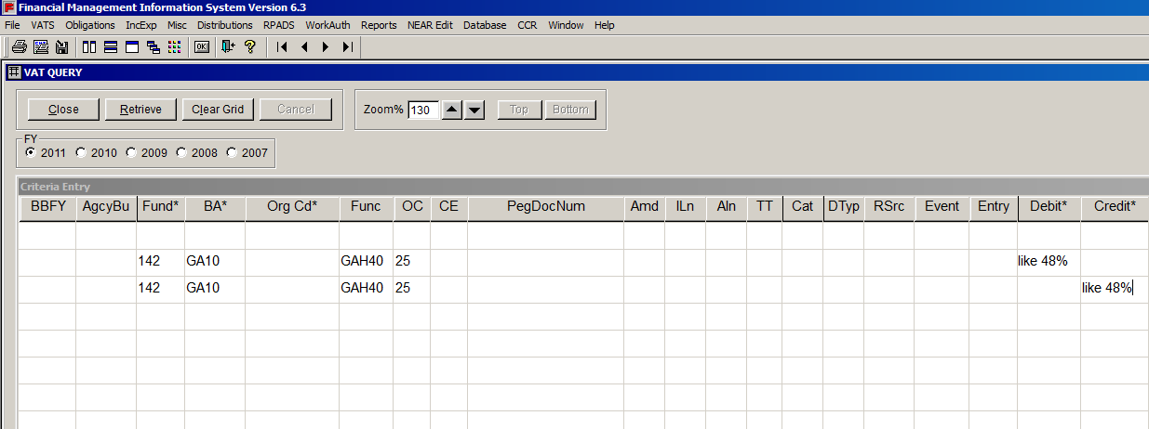
Query Grids provide an Excel-like method of executing a search for transactional data in FMIS
Consider the following example: A FMIS user wants to search for the same kind of transactions that have 48% in both General Ledger Debit and Credit. How can this be accomplished?
Choose the correct Fiscal Year (in this example, the FY is 2011)
Enter the Fund Code (in this example, the code is 142)
Enter the Budget Activity (in this example, the code is GA10)
Enter the Function Code (in this example, the code is GAH40)
Enter the Object Class Code (in this example, the code is 25)
Add a second line to repeat the same data, separating Debit and Credit on two lines
Select “Retrieve”
1
2
3
4
5
6
1
6
5
2
3
4
18
Notes:
18
- This is an example of a typical query grid

Slide 19
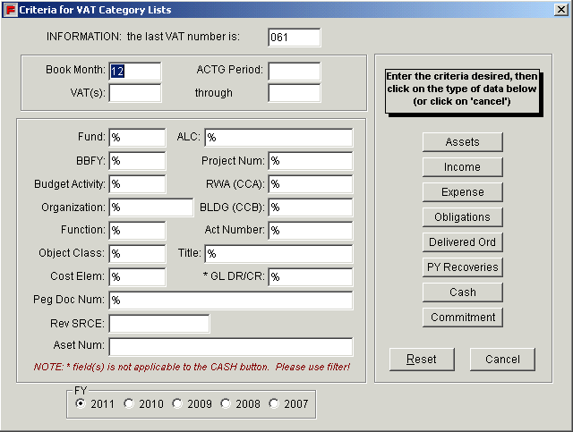
Non-Query Grids use form fields for search parameters for standard transactional data from FY2007-2011
The primary Non-Query Grid is the ‘VAT Category Lists.’ Here you can select transactions without knowing the general ledgers
Specifically, to run a VAT Category Non-Query Grid:
Select the date range of your query, or enter the VAT range for the period of your interest
You will need to enter at least one accounting element search criteria
Select which fiscal year you wish to view
Click one of the categories of data (Income, Expense, Obligation, Undelivered Order or PY Recovery)
Note that Wild Cards can also be used in Non-Query Grids
VAT Category List Non-Query Grid
1
1
2
2
4
3
4
3
19
Notes:
19
- If you want to run a query for the whole fiscal year, you do not need to enter the VAT range for the whole fiscal year but just leave unpopulated the FM, AP and VATS range fields so that FMIS will pull all fiscal year information
- Point out that non-query grids will prompt users when a Wild Card search is available to query

Slide 20
Frequently Used Queries
The most frequently used queries which meet most user’s data needs include:
VAT Query Grid
VAT Search
Transactions by Document Numbers
Income and Expense
Obligations
Pegasys Open Items - Summary & Detail
Pegasys Trial Balance - Summary and Detail
Work Authorization
RPADS and RPADS Capital Report
20
Notes:
20

Slide 21
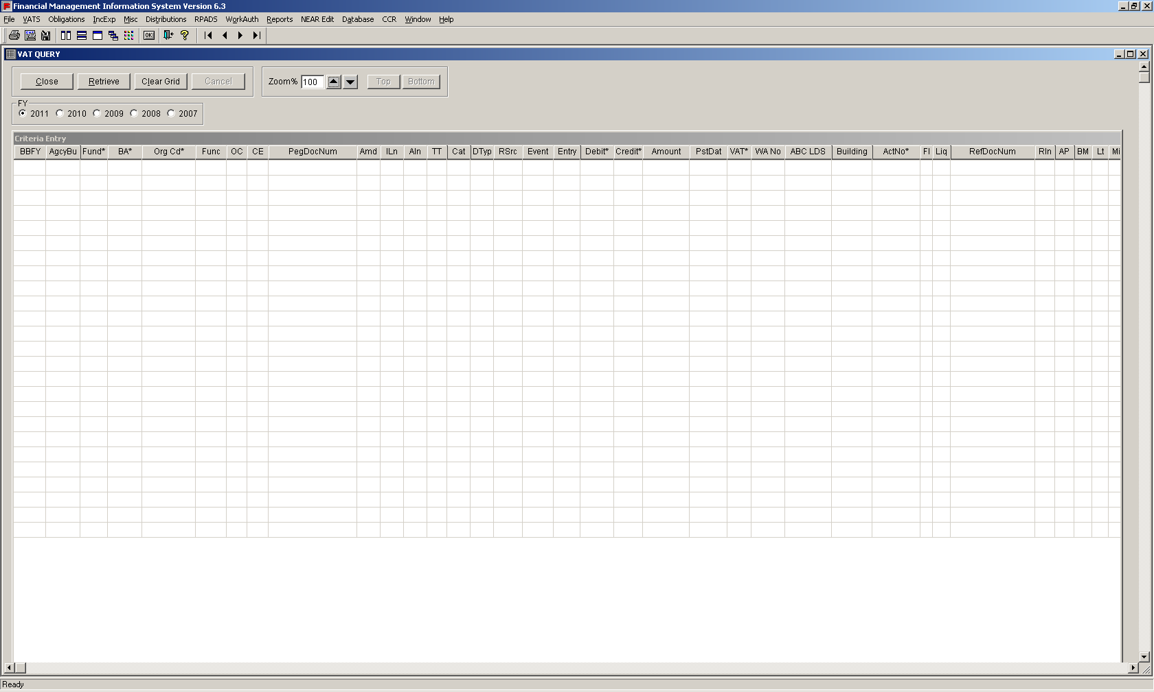
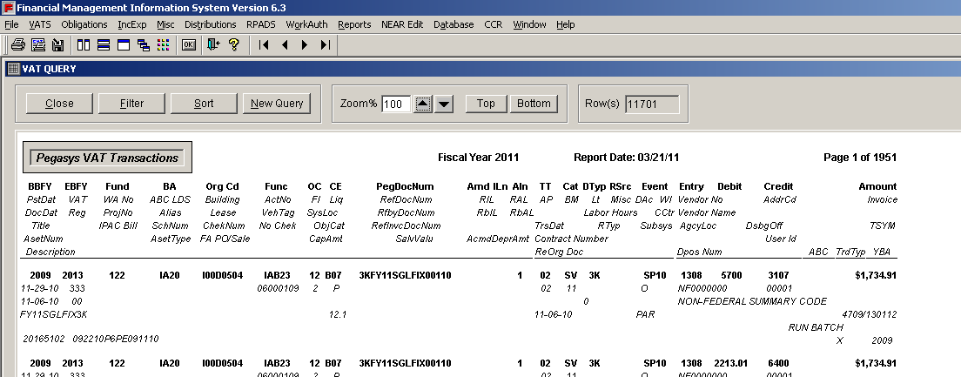
Frequently Used Queries: VAT Query Grid
VAT Query Grid
Screenshot of Query
How to get there: VATS menu → VAT Query Grid
When to use:
To verify posting of transactions and determine account balance
To generate information on all transactions that took place during a fiscal year
What query includes: All Pegasys data elements are available in the VAT query grids
There are additional Pegasys-centric data elements available, such as:
Pegasys Document Number
Document Type
Document Category
Transaction Type
Accounting Event
Screenshot of Query Report
21
Notes:
21
- Think of the VAT Query Grid as the ‘Swiss Army Knife’ of the queries in FMIS – it allows users to be very flexible and do a lot of tihngs with their queries

Slide 22
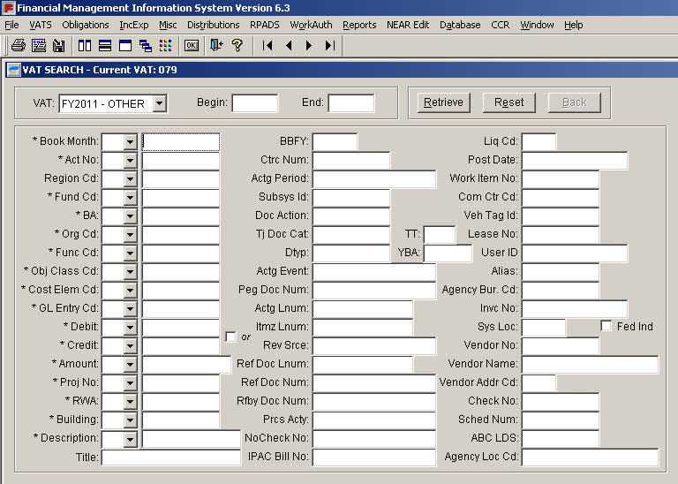
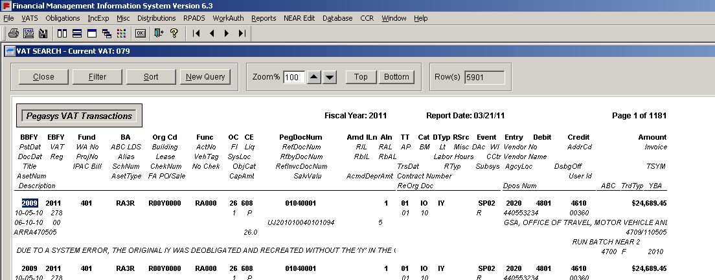
Frequently Used Queries: VAT Search
VAT Search
Screenshot of Query
How to get there: VATS menu → List of VAT Numbers
When to use:
To extract transactions (or VAT)
To generate similar results as that of the VATS Query Grid with Filter and Sort functions
What query includes: This query includes VATs being processed in each fiscal year. It also tells you the Load Date as well as the Records Count
Screenshot of Query Report
22
Notes:
22

Slide 23
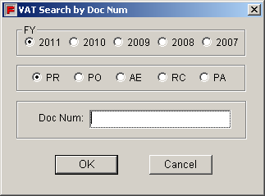
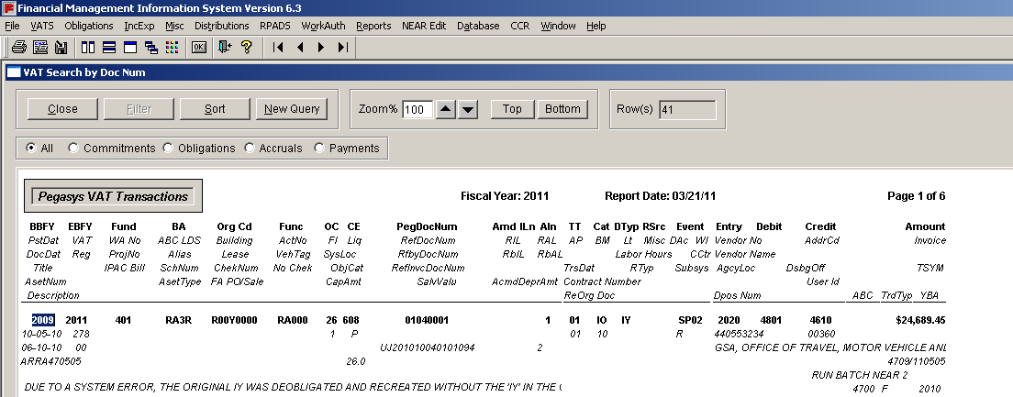
Frequently Used Queries: Transactions by Document Numbers
Transactions by Document Numbers
Screenshot of Query
How to get there: VATS menu → Transaction by Document Number(s) → enter a Purchase Order number → click ‘PO’ and the FY of interest
When to use:
To obtain accounting transactions/entries for all documents that are related to the input document
To display any related payments
What query includes: This query includes accounting transactions and entries for all documents that are related to the input document. The report will show the purchase order as well as associated receipts. If there is any payment, the report will also show that
Screenshot of Query Report
23
Notes:
23

Slide 24
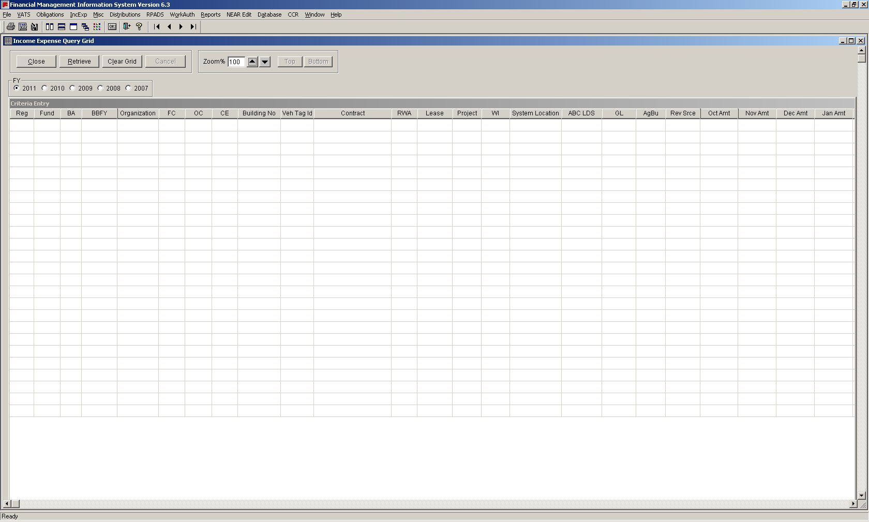
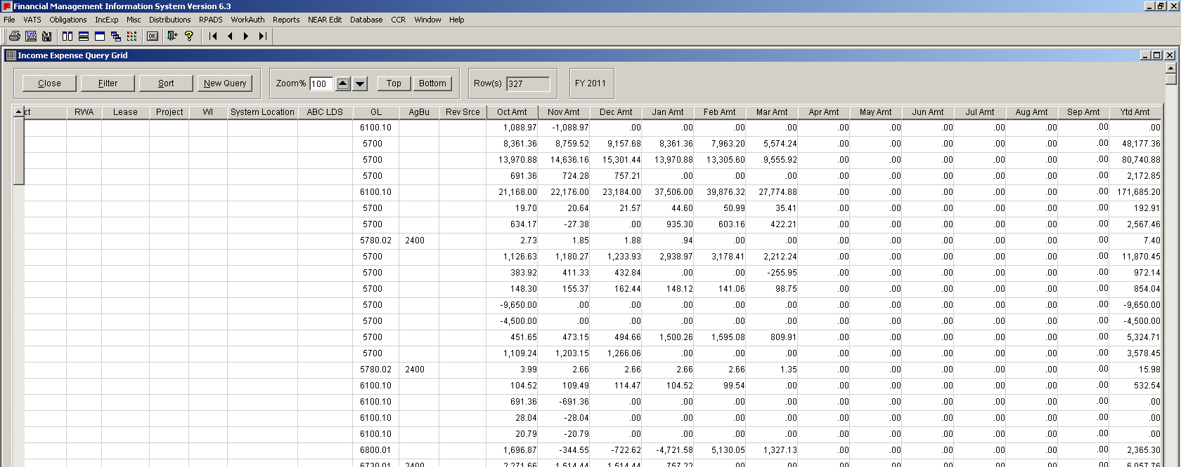
Frequently Used Queries: Income and Expense – Query Grid & Non-Query Grid
Income and Expense – Query Grid
Screenshot of Query
How to get there: IncExp menu → Query grid
When to use:
To display monthly columns and a consolidated amount at a summarized level without additional transactional detail
To display the income and expense for any building by book month as well as by fiscal year
To display the GA Overhead expense and DCC Distribution
What query includes: Income and Expense query reports include monthly columns and the amount income/expense consolidated at a summarized level
Screenshot of Query Report
24
Notes:
24

Slide 25
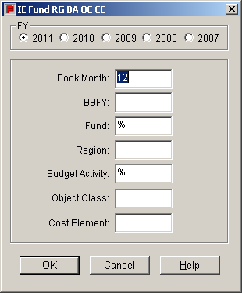
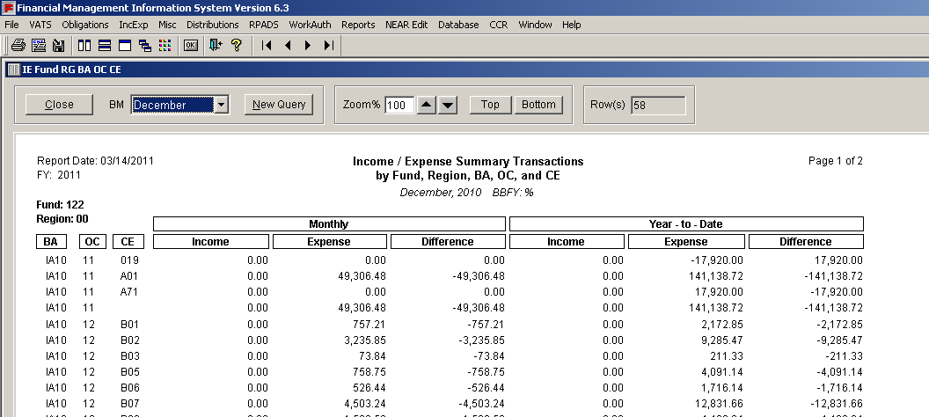
Frequently Used Queries: Income and Expense – Query Grid & Non-Query Grid
Income and Expense – Non-Query Grid
Screenshot of Query
How to get there: IncExp menu → Choose non-query grid
Non-Query Grids available:
Fund Ba
Fund Rg Ba
Fund Rg Ba Fc
Fund Rg Ba Oc
Fund Rg Ba Oc Ce
Fund Rg Ba Org
Fund Rg Ba Org Fc Oc Ce
Fund Rg Oc Ce
Fund Rg Org Ba
Fund Rg Ba Org Oc Ce
Fund Rg Org Ba Fc Oc Ce
When to use:
To view current and year to date income, expenses and net income
What query includes: Income and Expense query reports include monthly columns and the amount income/expense consolidated at a summarized level
Screenshot of Query Report
* Rg = Region, Fc = Function Code, Ba = Budget Activity, Oc = Object Class, Ce = Cost Element
25
Notes:
25

Slide 26
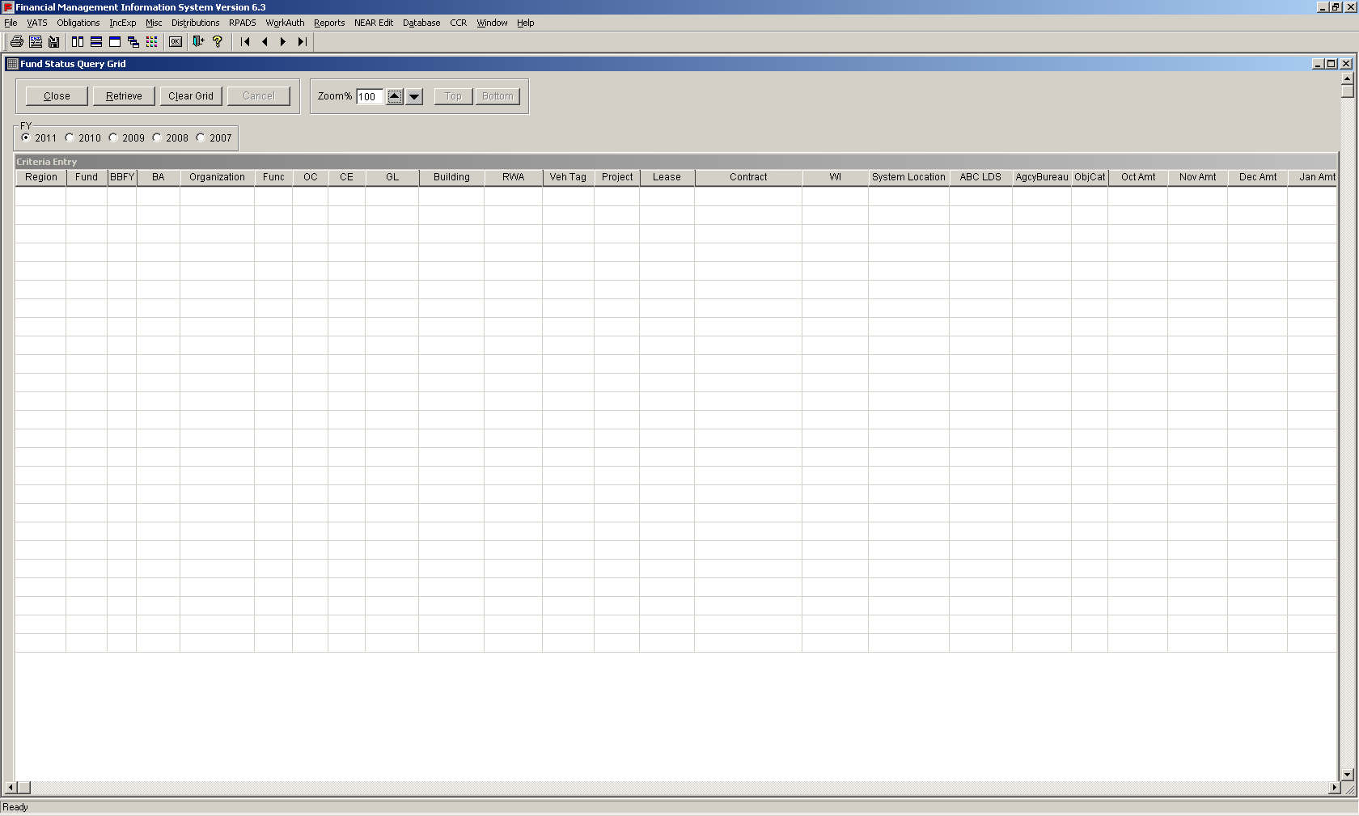
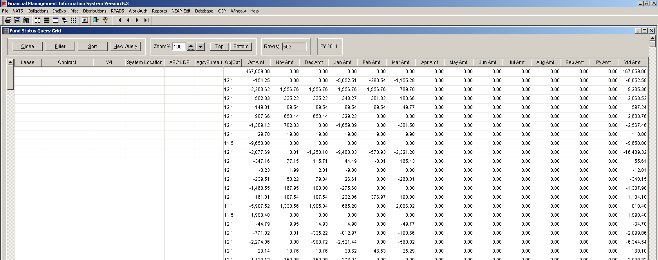
Frequently Used Queries: Obligations – Query Grid & Non-Query Grid
Obligations – Query Grid
Screenshot of Query
How to get there: Obligations menu → Query Grid
When to use:
To extract Obligation and Delivered Order by book month
To display transactions in monthly columns at a summarized level
What query includes: Transactions are displayed in monthly columns at a summarized level. The canned-queries allow you to create obligation reports based on pre-formulated search criteria and query report outputs
Screenshot of Query Report
26
Notes:
26

Slide 27
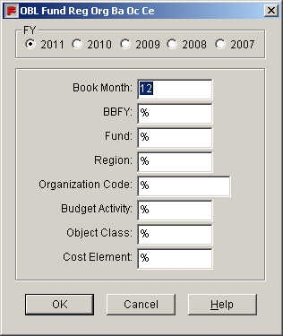
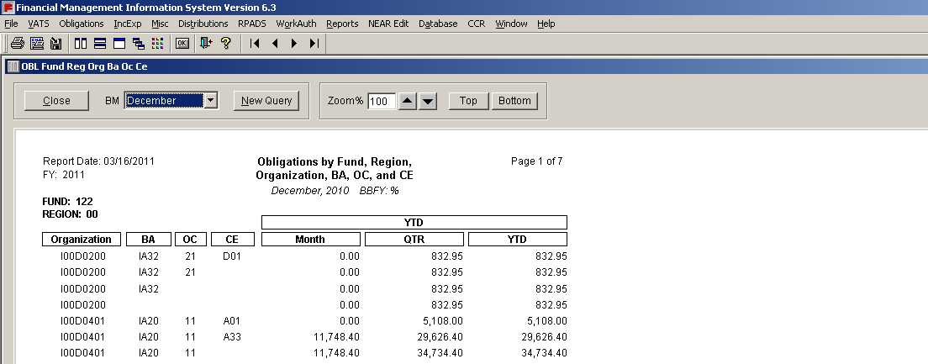
Frequently Used Queries: Obligations – Query Grid & Non-Query Grid
Obligations – Non-Query Grid
Screenshot of Query
How to get there: Obligations menu → Non-Query Grid
When to use:
To extract Obligation and Delivered Order by book month
To display transactions in monthly columns at a summarized level
What query includes: Transactions are displayed in monthly columns at a summarized level. The canned-queries allow you to create obligation reports based on pre-formulated search criteria and query report outputs
Screenshot of Query Report
27
Notes:
27

Slide 28
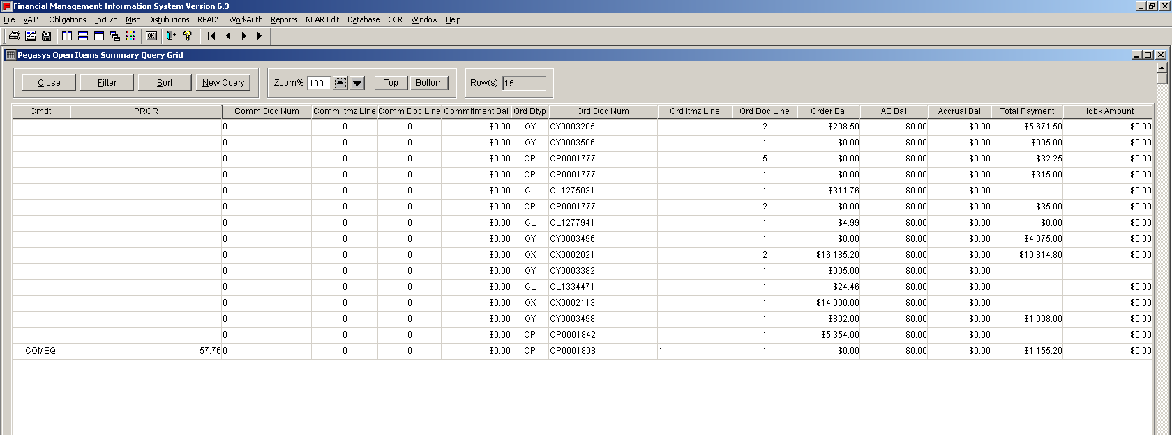
Frequently Used Queries: Pegasys Open Items – Summary & Detail
Pegasys Open Items – Summary
Screenshot of Query
How to get there: Misc. menu → Open Items Summary
When to use:
To obtain information on obligations or open balances, the accrual/receipt open balance, and the total of all payments for a particular Order or Accounting Line
To search ALL Documents that link to a particular Request, Purchase Order, Receipt and Payment and display the balance/amount of each document
To use a Payment Document Number to generate results for Receipts, Orders, and Requests
What query includes: If you enter a Purchase Request Document Number the query will return all documents that link to that Purchase Request. If you enter a payment document number, the query will return all receipts, order and requests
Screenshot of Query Report
28
Notes:
28

Slide 29
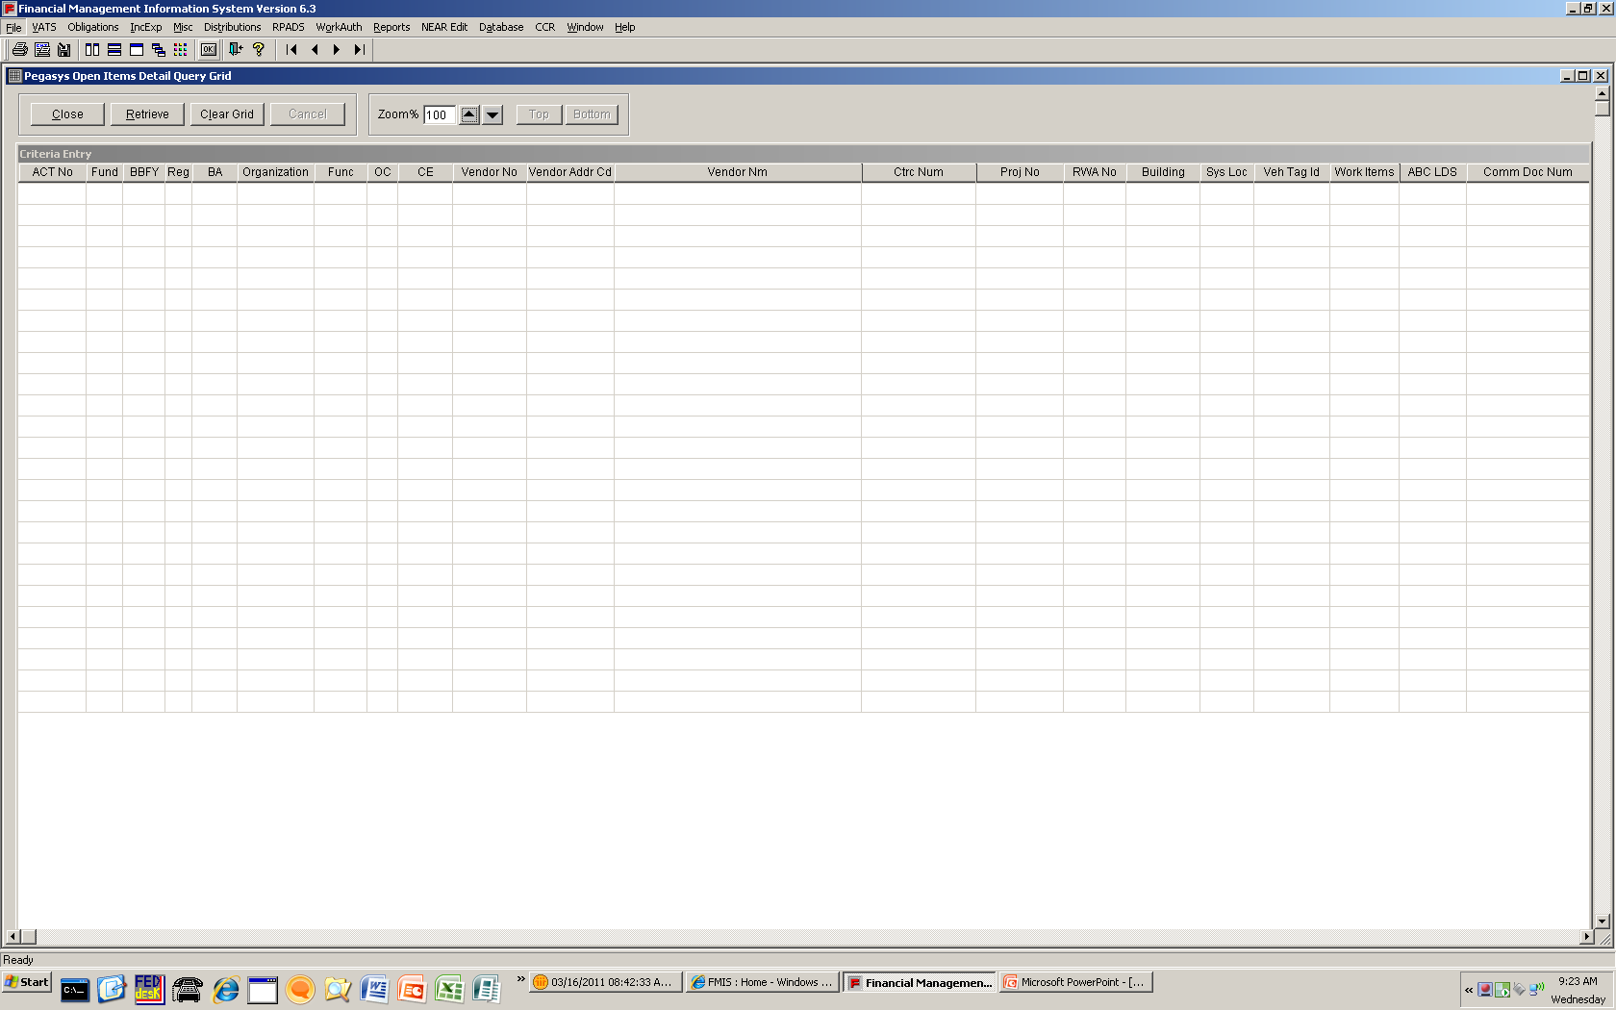
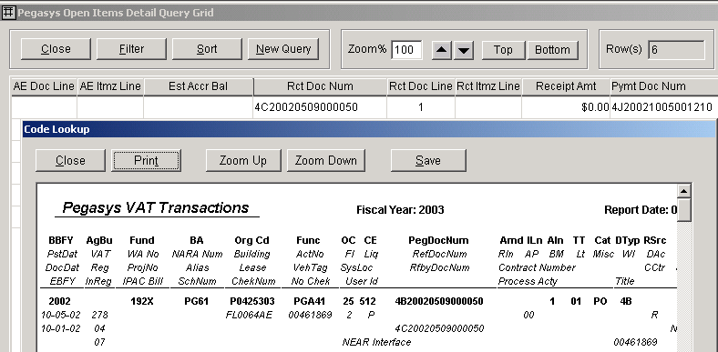
Frequently Used Queries: Pegasys Open Items – Summary & Detail
Pegasys Open Items – Detail
Screenshot of Query
How to get there: Misc. menu → Open Items Detail
When to use:
To obtain information on obligations or open balances, the accrual/receipt open balance, and the total of all payments for a particular Order or Accounting Line
To search ALL Documents that link to a particular Request, Purchase Order, Receipt and Payment and display the balance/amount of each document
To use a Payment Document Number to generate results for Receipts, Orders, and Requests
What query includes: If you enter a Purchase Request Document Number the query will return all documents that link to that Purchase Request. If you enter a payment document number, the query will return all receipts, order and request (when applicable).
Screenshot of Query Report
29
Notes:
29

Slide 30
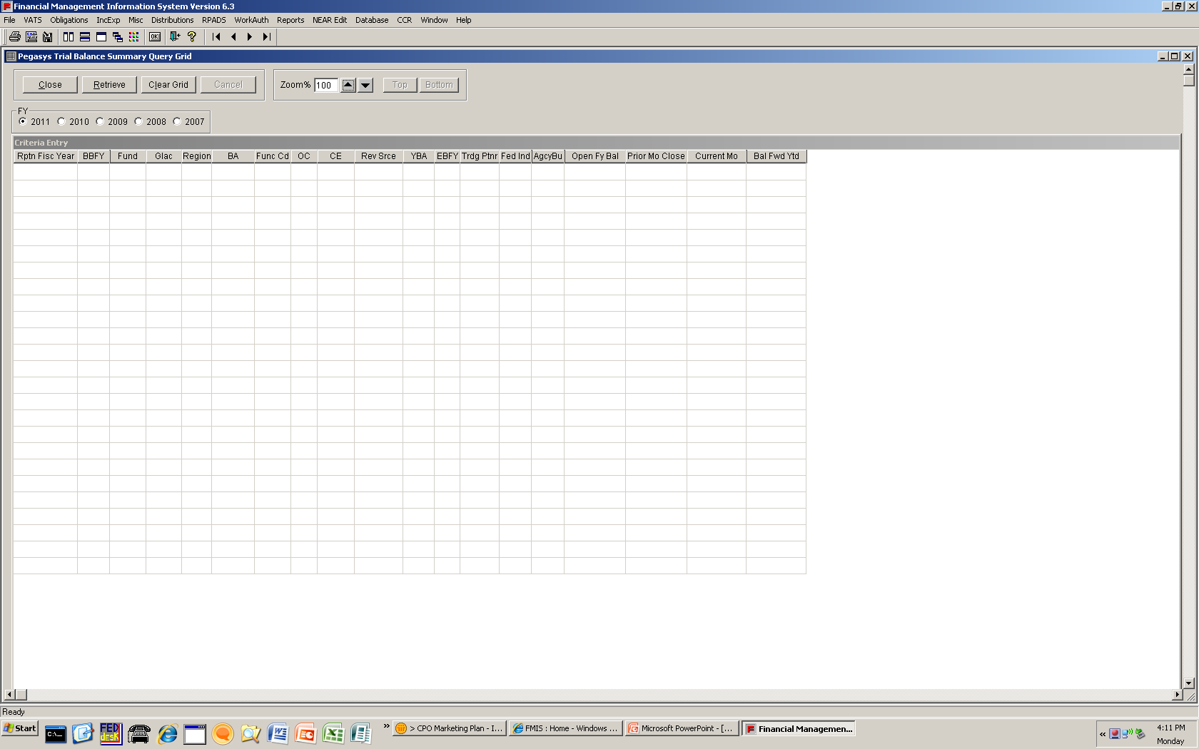
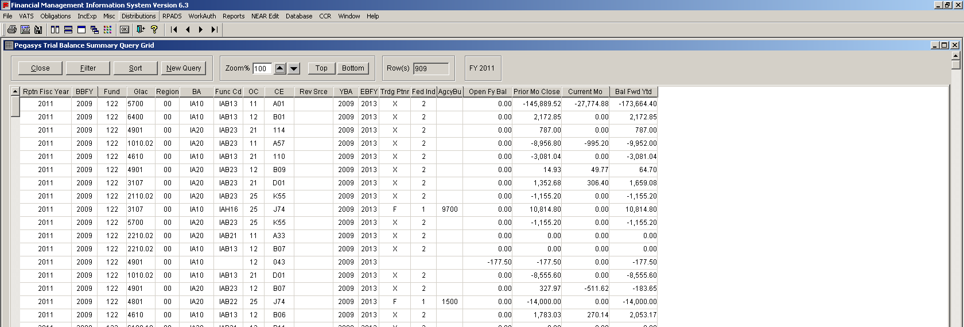
Frequently Used Queries: Pegasys Trial Balance – Summary & Detail
Pegasys Trial Balance – Summary
Screenshot of Query
How to get there: Misc. menu → Trial Balance Summary
When to use:
To view Pegasys Trial Balances in summary, including Prior Month Close, Change in the current month and Year to Date Balance
To obtain a quick balance of a Fund and Standard General Ledger and obtain a quick glance at current month change
What query includes: This query grid allows you to look at Pegasys Trial Balances. In the detail query grid, you will view the month’s activity in the Trial Balance. The summary Trial Balance allows you to view Prior Month Close, Change in the current month and Year to Date Balance
Screenshot of Query Report
30
Notes:
30

Slide 31
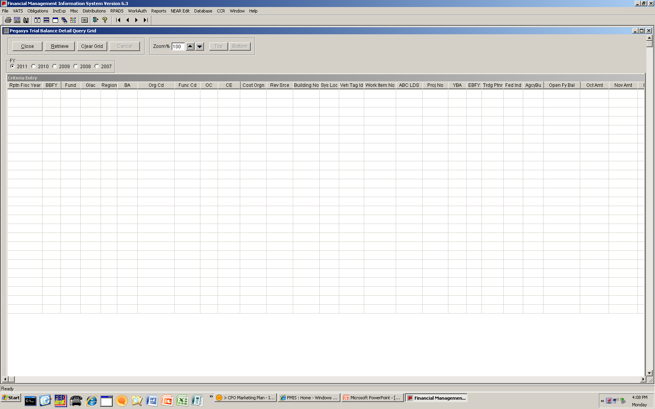
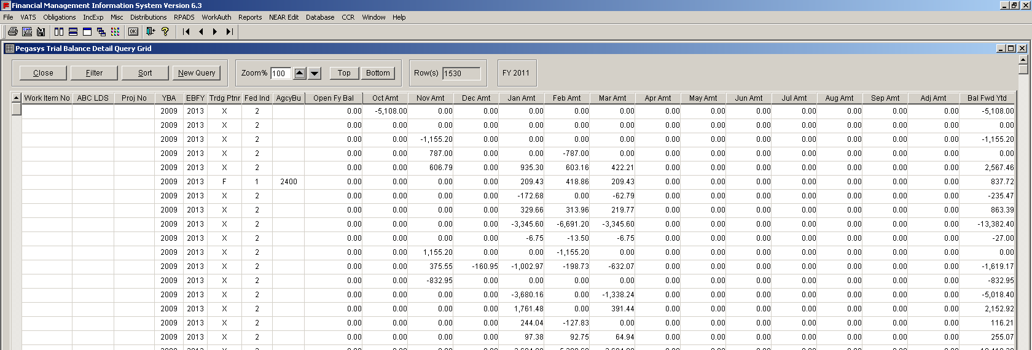
Frequently Used Queries: Pegasys Trial Balance – Summary & Detail
Pegasys Trial Balance – Detail
Screenshot of Query
How to get there: Misc. menu → Trial Balance Detail
When to use:
To view Pegasys Trial Balances in detail, with monthly itemizations
What query includes: This query grid allows you to look at Pegasys Trial Balances. In the detail query grid, you will view the month’s activity in the Trial Balance. The summary Trial Balance allows you to view Prior Month Close, Change in the current month and Year to Date Balance
Screenshot of Query Report
31
Notes:
31

Slide 32
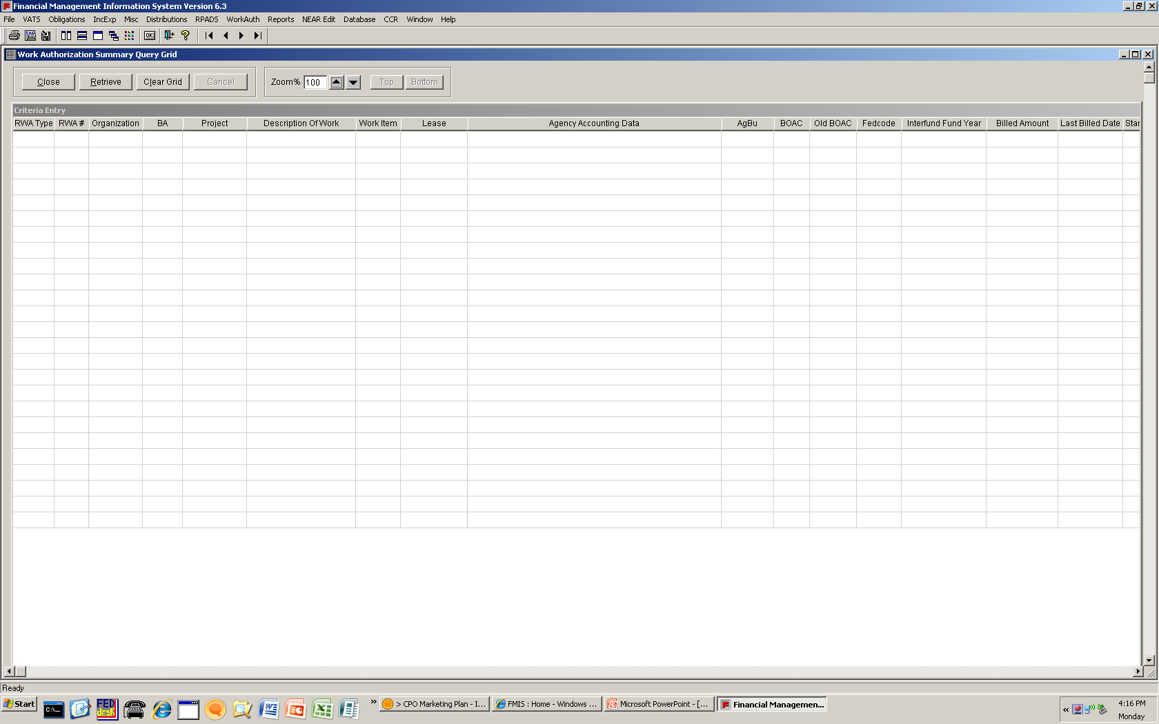
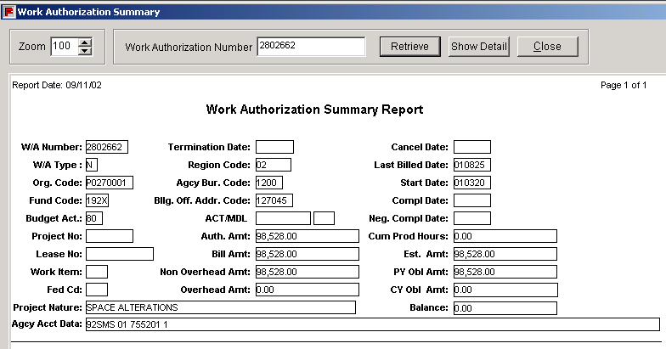
Frequently Used Queries: Work Authorization – Summary & Detail
Work Authorization – Summary
Screenshot of Query
How to get there: WorkAuth menu → Work Authorization Summary
When to use:
To generate reports pertaining to Reimbursable Work Authorizations (RWAs)
What query includes: WorkAuth query reports contain data pertaining to RWAs imported from the RWA database
Screenshot of Query Report
32
Notes:
32

Slide 33
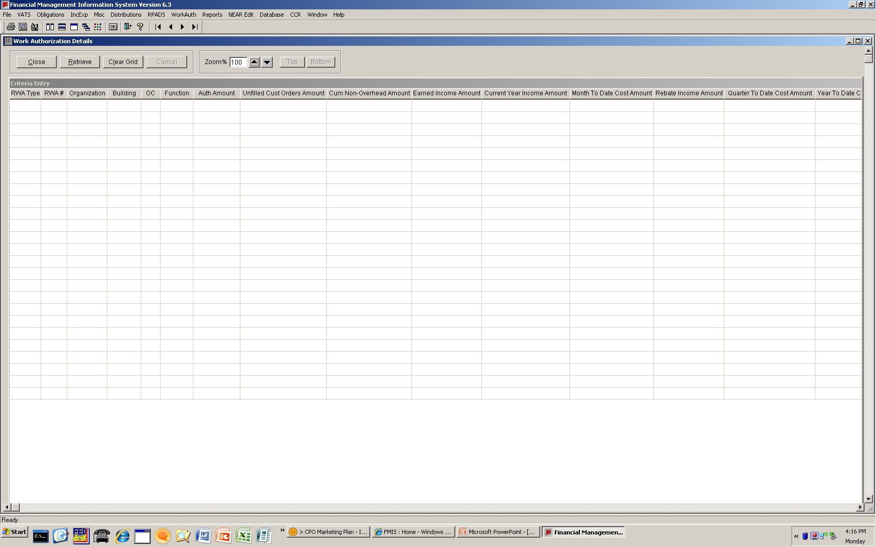
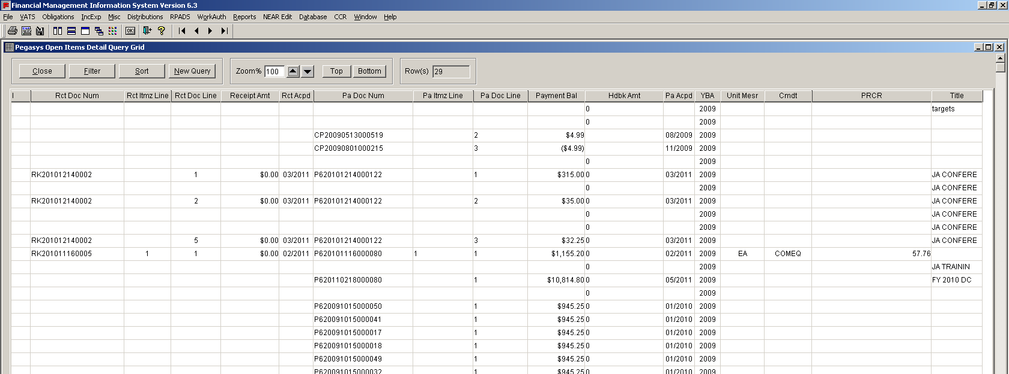
Frequently Used Queries: Work Authorization – Summary & Detail
Work Authorization – Detail
Screenshot of Query
How to get there: WorkAuth menu → Work Authorization Detail
When to use:
To generate reports pertaining to Reimbursable Work Authorizations (RWAs)
What query includes: WorkAuth query reports contain data pertaining to RWAs imported from the RWA database
Screenshot of Query Report
33
Notes:
33

Slide 34
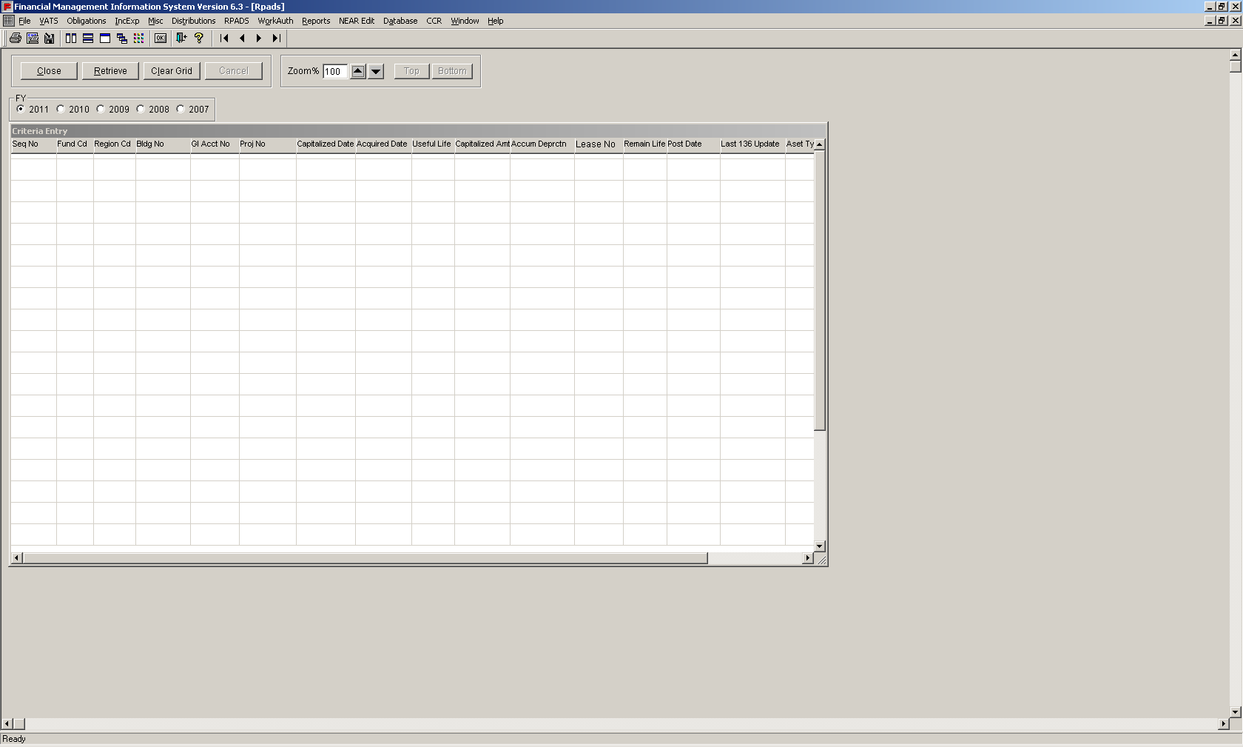
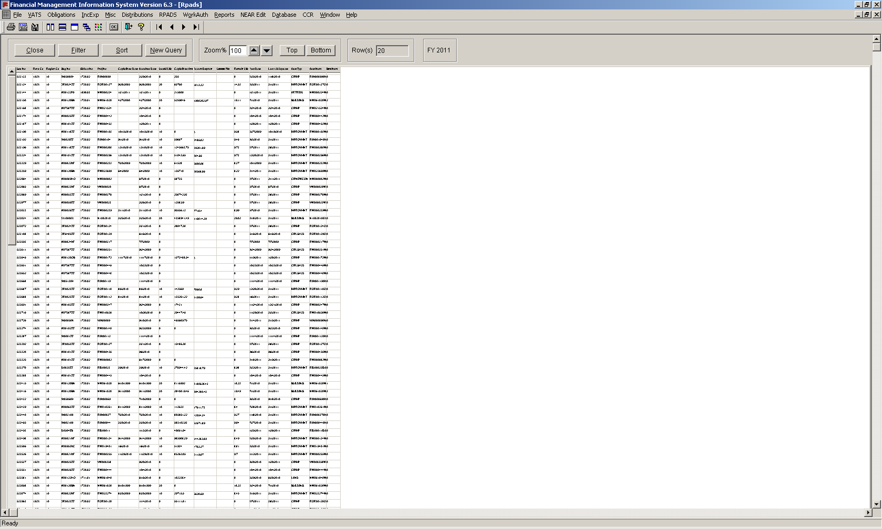
Frequently Used Queries: RPADS and RPADS Capital Report
RPADS
Screenshot of Query
How to get there: RPADS menu → RPADS
When to use:
To add personalized query search criteria to generate RPADS data
What query includes: The RPADS Query Grid and the RPADS Capital Report capture depreciation and capitalization information for all buildings for Fund 192X
Screenshot of Query Report
34
Notes:
34

Slide 35
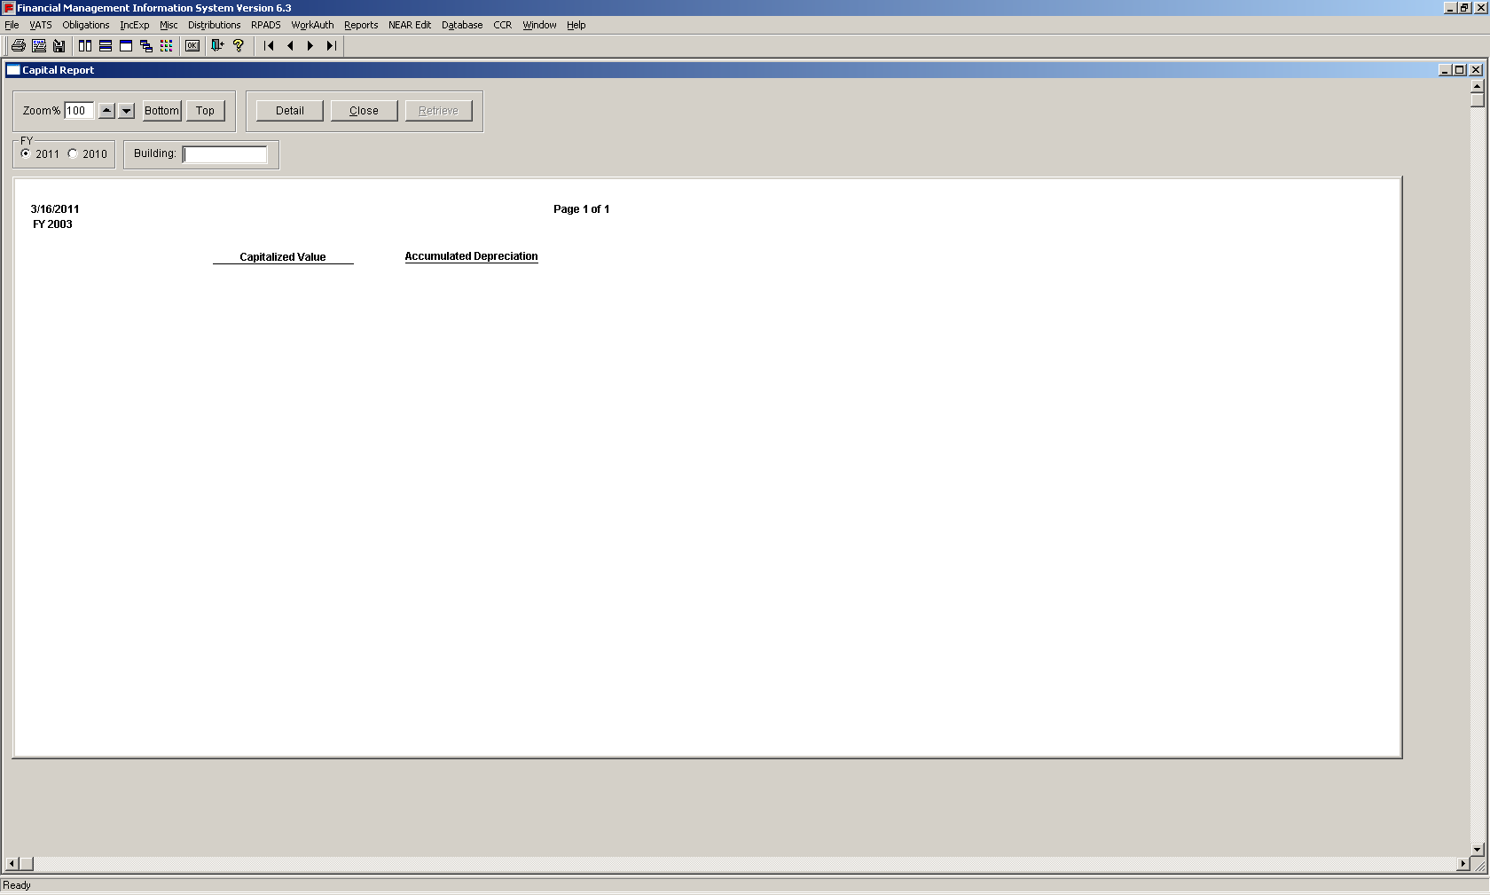
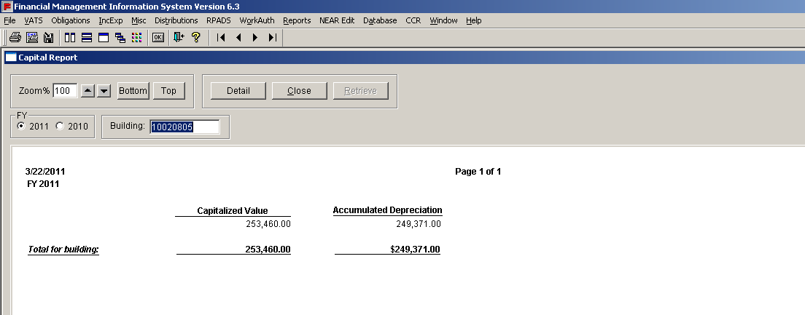
Frequently Used Queries: RPADS and RPADS Capital Report
RPADS Capital Report
Screenshot of Query
How to get there: RPADS menu → RPADS Capital Report
When to use:
To add personalized query search criteria to generate RPADS data
What query includes: The RPADS Query Grid and the RPADS Capital Report capture depreciation and capitalization information for all buildings for Fund 192X
Screenshot of Query Report
35
Notes:
35

Slide 36
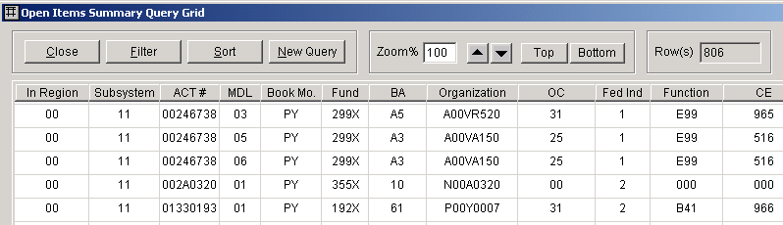
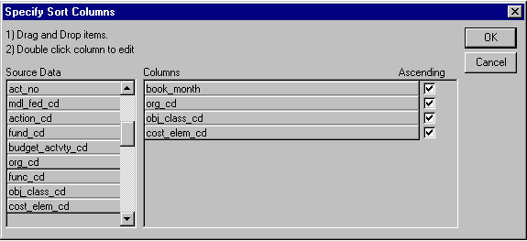
Sorting data in an executed query is a quick, three-step process
1
To sort data returned from an executed query:
Click the ‘Sort’ button.
Click and drag the Source Data elements you wish to see in the report from the left to the empty space on the right in the Columns area
The default sort order is ascending order, beginning with the first. Remove the checkmark underneath Ascending to change the sort order to descending
1
2
2
3
3
Multiple sorts are also possible to perform. For example, to sort by the accounting dimension ‘cost element’ within the accounting dimension ‘object class’: drag and drop obj_class_cd, then drag and drop cost_elem_cd underneath obj_class_cd
36
Notes:
36
- When rows are not sorted, they will be displayed in the same order they were created in the database (latest records being listed last)

Slide 37
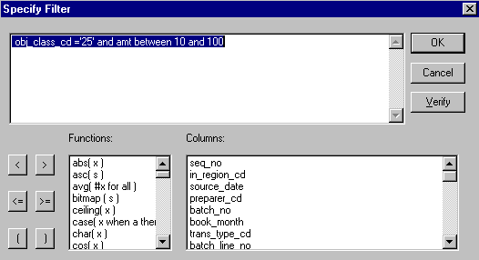
Filtering data in a query report requires a thorough understanding of the operations involved
1
To filter data returned from a query:
To filter data, click the ‘Filter’ button
Select the accounting dimension you wish to filter in the ‘Columns’ box, click it and paste into the empty space above
Next, type =, a space, a single quotation mark (‘), the value for which you wish to filter (in the example 25), and another single quotation mark
Filters can be combined. In the example, the ‘and’ operator is used to include amounts (amt) between 10-100
Click ‘OK’
1
2
3
4
3
5
4
5
2
Do not use quotation marks for a range of numeric values, such as when using ‘Between’ or ‘Greater than.’ For example, to filter for amounts greater than $5,000, use the following expression: amt > 5000
Unlike the rest of the FMIS application, filter expressions are case sensitive (for example, use a capital P in organization code, not a lowercase p)
37
Notes:
37

Slide 38
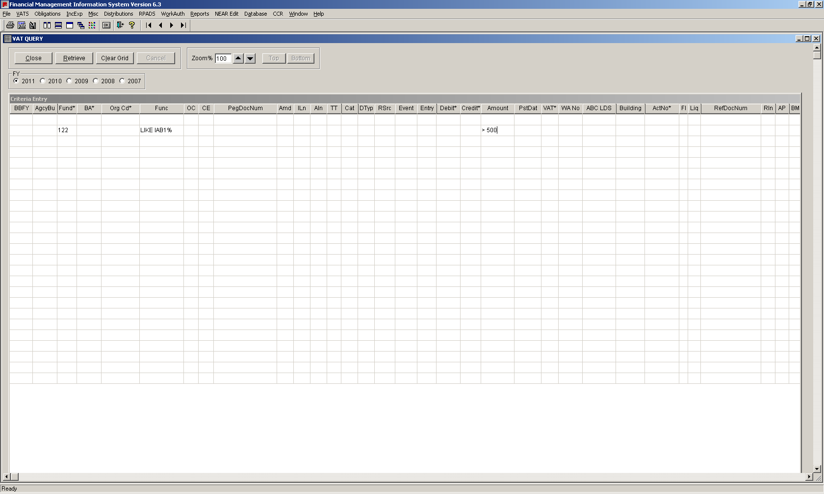
Exercise: You want to create a VAT query for transactions from 2011, with any function code that begins with IAB1, the fund code is 122 and the amount is more than $500 – how would you create this?
Choose FY 2011 → On the same row: 122 under Fund → LIKE IAB1 under Func → GREATER THAN 500 under Amount → Click ‘Retrieve’
Choose FY 2011 → On the same row: 122 under Fund → LIKE IAB1% under Func → GREATER THAN $500.00 under Amount → Click ‘Retrieve’
Choose FY 2011 → On the same row: 122 under Fund → LIKE IAB1% under Func → > 500 under Amount → Click ‘Retrieve’
Choose FY 2011 → On different rows: 122 under Fund → LIKE IAB1% under Func → GREATER THAN 500 under Amount → Click ‘Retrieve’
38
Notes:
38
- Remember to add the appropriate Wild Card operator (choice A)
- Do not enter dollar signs or commas as separators in dollar values (choice B)
- Since each query element is joined by an ‘AND’ statement, everything should be on one line (choice D)

Slide 39
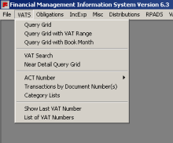
Exercise: Your boss wants to verify the number of transactions in Pegasys and review yesterday’s cash transactions for reconciliation purposes – which report do you run?
VATS Category Lists
Pegasys Open Items Summary
Pegasys Trial Balance Detail
VAT Search
39
Notes:
39
- The VAT Category List is a non-query grid which allows users to quickly search VAT-related data for a specific type of transaction
- Users can also use the VAT Query Grid to verify cash transactions, using the appropriate code in the debit/credit accounting dimension field

Slide 40

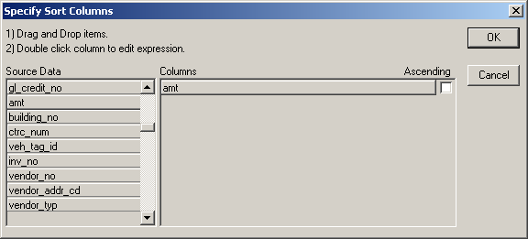
Exercise: The results of a Query Grid are overwhelming; you are interested in the orders with the highest obligated amount being at the beginning of the report – how would you do this?
Re-run the query with a ‘greater than’ operator to create a minimum threshold of query results
Click Sort to sort the data by obligated amount, then uncheck the ascending box
Click ‘Filter’ and filter the data for orders above your dollar threshold of interest
If you ran a non-query grid report, try running a query grid report with more stringent parameters
40
Notes:
40

Slide 41
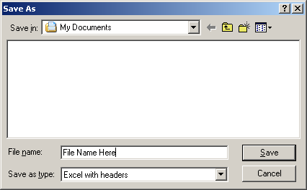
FMIS users are able to save queries directly to their workstation or network client drives for ease of access
To save a report generated in FMIS, follow the five steps below:
Select ‘File Save As’ or by clicking ‘Save Data’ button
The default file format is text (.txt) with headers. Change the file type by selecting from the drop-down list labeled ‘Save as Type’ to ‘Excel with Header’
Second, name the file, keeping the file extension for the application (e.g. .xls for Excel)
Select C$ on Client drive for the file’s location
Click ‘Save’
1
1
2
4
3
4
5
2
3
5
Important Note: To save your query you must be logged-in with ‘Full Access’
41
Notes:
41
- Do not choose Excel5 – this format takes an unusual amount of time to save and produces erratic results when loaded into Excel

Slide 42
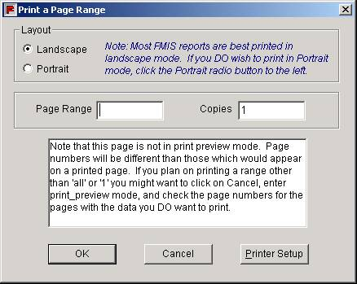
FMIS users can also print query reports to networked printers directly from the FMIS application
To print a query report generated in FMIS, follow the five steps below:
Click the ‘Print’ button or at the main menu, click ‘File,’ and choose ‘Print.’
You can choose to print a report in portrait or landscape format. It is recommended that you print reports in Landscape format
You will also be prompted to print a specific page or a range of pages (eg. 3-10) of report, or the entire report
Enter the number of copies you wish to print
Click ‘OK’
1
1
2
2
3
4
3
4
5
5
Important Note: To print your query you must be logged-in with ‘Full Access’
42
Notes:
42
- If you cannot print, and you are logged-in with full access, you may have an issue related to your connection with the Citrix Server which the OCFO Service Desk can fix

Slide 43

Exercise: You want to save a query to the Client your H: drive on the Network – how do you do that?
Drag the Query to your desktop – it will be saved in Excel format
Click File → Save As → Name file → Save as ‘Text with Headers’ → Choose ‘My Documents’ → Click ‘Save’
Click the Save Data icon → Choose to save the file as ‘Excel with Headers → Name the file → Choose the Directory and Sub-directory to save the file → Click ‘Save’
Nothing - all queries are automatically saved for one day on the network drive when you log-in to FMIS with Full Access rights
43
Notes:
43
- However, similar to answer B, you can also click ‘Save’ in the ‘File’ main menu bar; and saving the file as ‘Text with Headers’ will allow you to save files that exceed Excel’s file limit size. If a user wants to choose their H drive, he or she must go through My Network Places. Otherwise, the user can save to the C$ on Client drive for their own C drive.

Slide 44


Exercise: When you attempt to print your query, your printer is not available – how should you trouble shoot this?
Log-out of FMIS → Log-in to FMIS → Re-run your query and trying printing again
Check that you are logged-in with Full Access
Contact the IT Service Desk
Contact the OCFO Service Desk
This error requires the OCFO Service Desk’s support:
44
Notes:
44
- First, check to make sure that you are logged-in with Full Access Rights. If you are, at that point contact the OCFO Service Desk, who is required to fix the issue which has to do with the Citrix server

Slide 45
In closing, keep in mind the following points when using FMIS
Remember:
If you have trouble printing or saving your queries, first be sure to check that you are logged-in to FMIS with Full Access rights – then contact the OCFO Service Desk
Be sure to update both your Citrix and FMIS passwords before the 90-day password expiration date
The VAT Search query is useful for searching a specific VAT to locate off-setting posting in multiple funds and SGL’s
Obligation reports will allow you to determine the status of obligations for a Fund, Region, Object class, Budget activity, and Cost element, as well as prepare the monthly Budget to Actual Report for clients
Use the ‘Database’ functions as a reference for the data available in FMIS
The User Training Manual and Quick Reference Cards for each knowledge area are available on the FMIS website
45
Notes:
45
- Include any other recommendations, tips or tricks from experience as well – allow users to share their own best practices

Slide 46
Contact the OCFO Service Desk for additional user support
Please contact OCFO Service Desk for the following issues:
Create New User Accounts
Report Log-in Problems
Report Printing Problems
Report Data-Related Problems
All Other Technical Issues
Contact Information
Phone : 1-866-450-6588 (Mon-Fri 7:30am – 7:30pm EST)
Email: OCFOServiceDesk@gsa.gov
46
Notes:
46
- BUT, try to use the self-help steps we have discussed today (e.g. checking for Full Access user rights for printing/saving problems)

